Slide 1
Chest Pain in Children… Is it ever Cardiac?
P. Jamil Madati, MD

Slide 2
Outline:
Goals
Definitions
Epidemiology
Differential Diagnoses
EBM review
Methodical approach to evaluation & work up
Summary

Slide 3
Goals:
Review differential diagnosis for pediatric chest pain
Recognize the ‘red flags’ warnings that could suggest underlying cardiac disease
Review an evidence based, methodical, cost and time effective work up for children presenting with chest

Slide 4
Definition:
For the purpose of this talk…
Age < 19yo
Presenting Chief Complaint of chest pain
Otherwise healthy patient with no underlying medical condition that would predispose patient to getting cardiac related chest pain
Prior cardiac history (Congenital heart disease, known arrhythmias etc)
Medically complex patients (Cerebral Palsy, Developmental delay/Non verbal kids)

Slide 5
Epidemiology:
National Hospital Ambulatory Medical Care Survey Data (NHAMCS) 2010
Chest pain is the 2nd most common visit to the ED (all comers)
BUT… not a common complaint for pediatric patients
Not in top 10 chief complaint for children < 15yo presenting to ED
Not in top 10 discharge diagnosis for children < 15yo

Slide 6
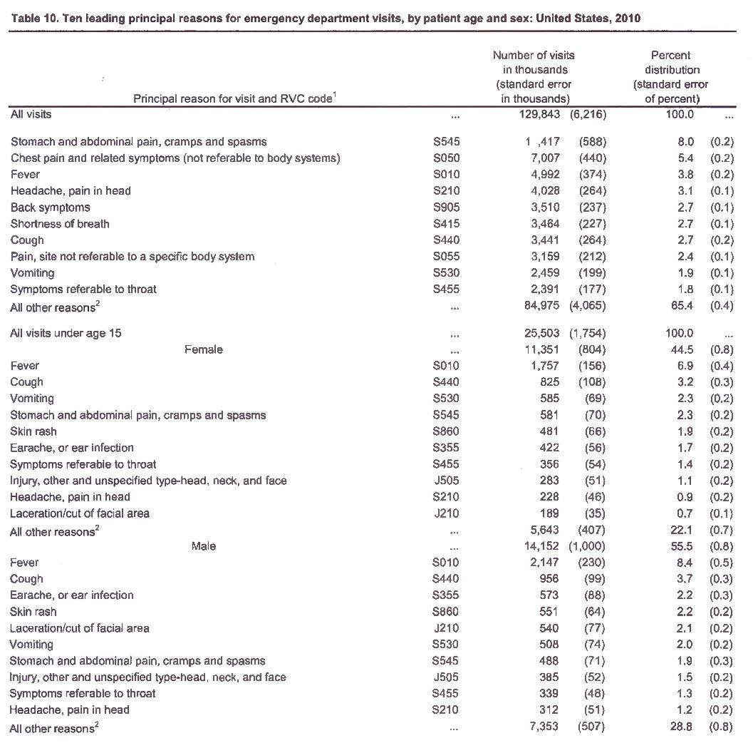

Slide 7
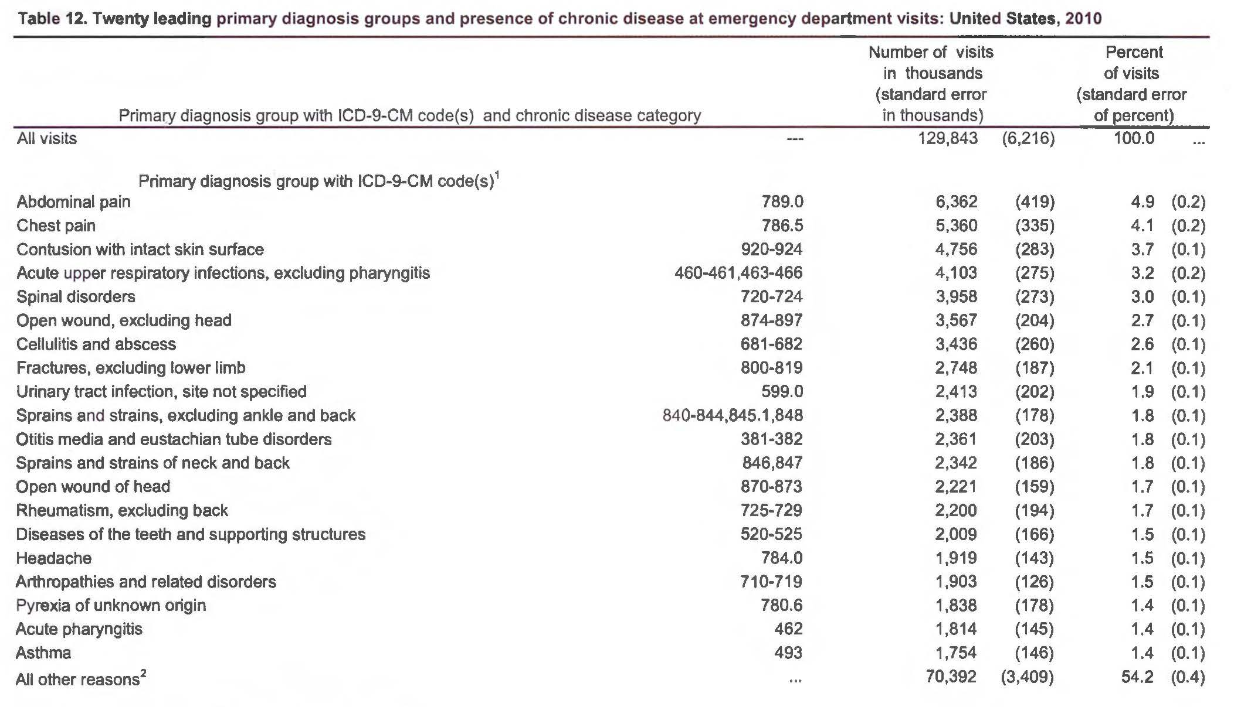

Slide 8
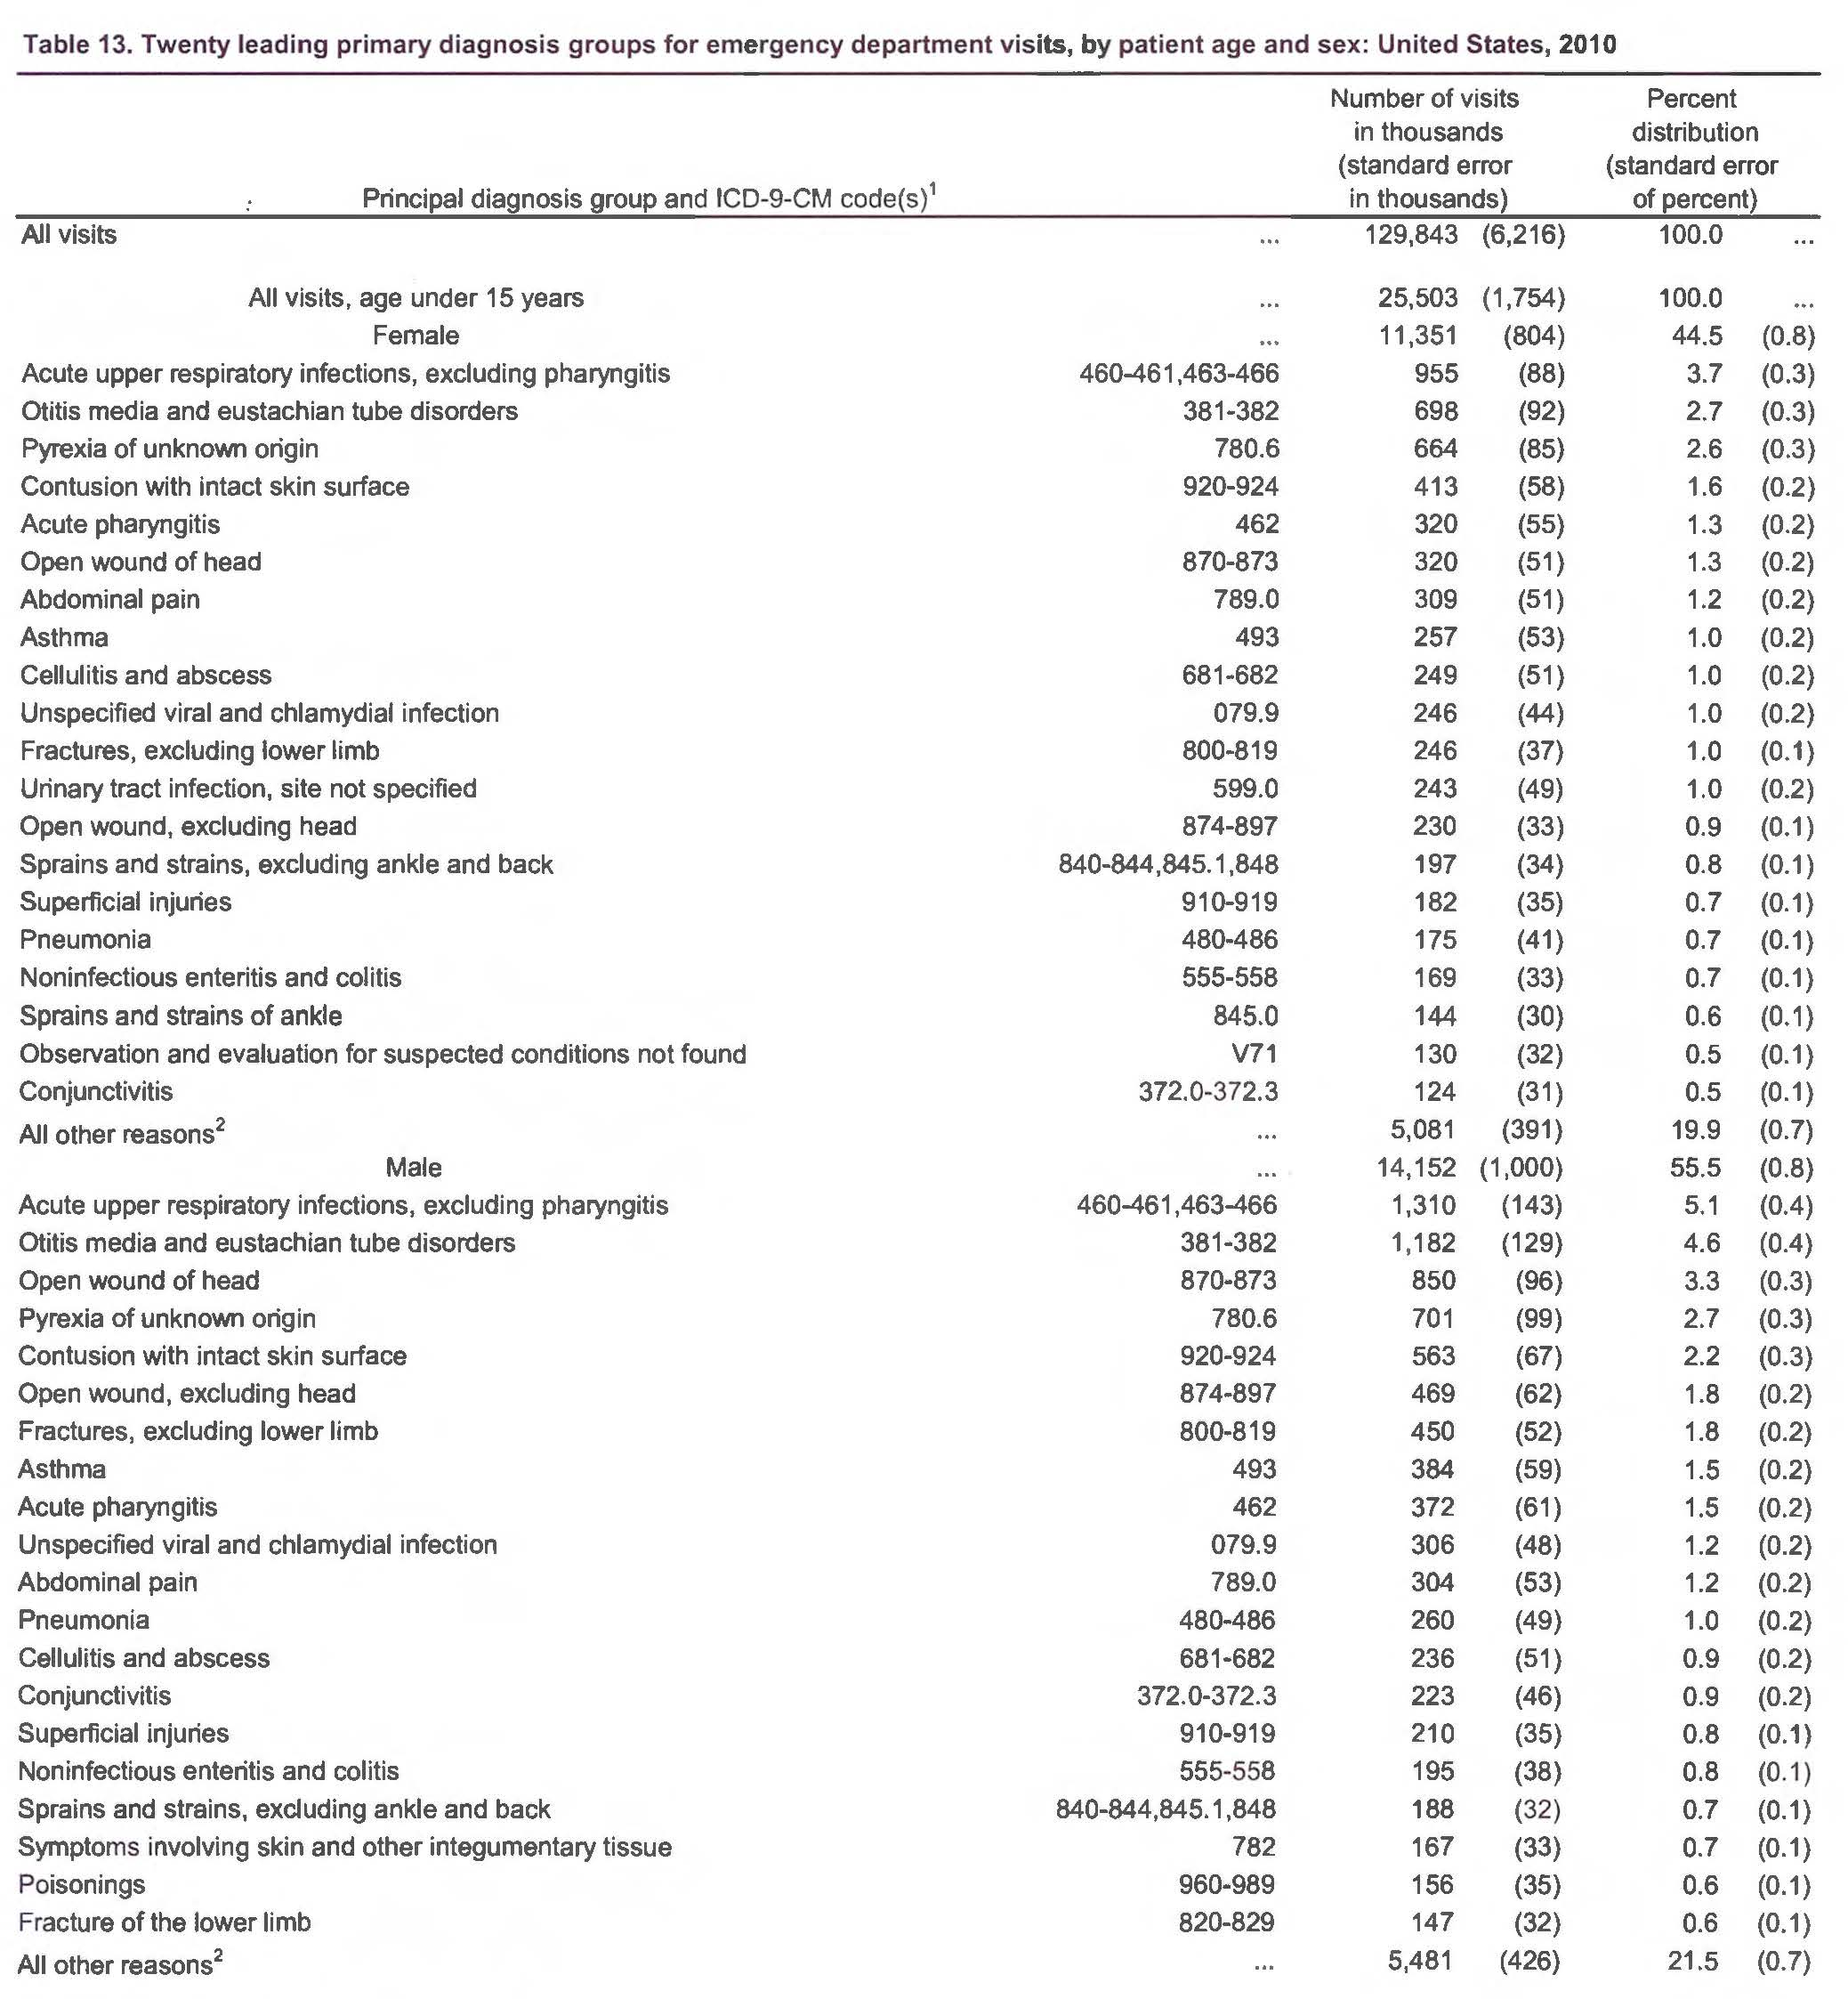

Slide 10
Differential Diagnosis:
Musculoskeletal/Skin
Contusion, trauma, costochondritis, zoster etc
Pulmonary
Asthma, pneumonia, FB, pneumothorax, HbSS/acute chest, pulmonary embolus
Psychiatric
Panic attacks/anxiety, psychosomatic, malingering
Cardiac
MI/Angina, pericarditis, myocarditis, arrhythmias, cardiomyopathies, endocarditis
Gastrointestinal
GERD/gastritis, FB, caustic ingestions
Other
Malignancy (chest mass)
Rheumatologic diseases (SLE, KD)
Tox/Illicit drugs

Slide 11
Differential Diagnosis:
Musculoskeletal/Skin
Contusion, trauma, costochondritis, zoster etc
Pulmonary
Asthma, pneumonia, FB, URI, pneumothorax, HbSS/acute chest, pulmonary embolus
Psychiatric
Panic attacks/anxiety, psychosomatic, malingering
Cardiac
MI/Angina, pericarditis, myocarditis, arrhythmias, cardiomyopathies, endocarditis
Gastrointestinal
GERD/gastritis, FB, caustic ingestions
Other
Malignancy (chest mass)
Rheumatologic diseases (SLE, KD)
Tox/Illicit drugs

Slide 12
EBM: Cardiac Causes of Chest Pain
Pediatric patients with chest pain
~1-5% will have cardiac etiology
Not common but could be fatal if not diagnosed promptly
AHA, ACEP, Friedman et al, Drossner et al

Slide 13
Evaluation:
Detailed history and physical
Family history of cardiac events
Drug/Illicit substance use history
Testing is rarely indicated unless you encounter ‘red flags’

Slide 14
Methodical Work Up:
Detailed history that includes
Location of pain, severity, exacerbating or alleviating factors, associated symptoms and radiation of pain
PMHx of conditions that may pre-dispose patient to cardiac etiology of chest pain
Fam Hx of early cardiac disease or deaths in family. Also of thrombotic diseases.
Illicit drug use, medications the patient is currently taking

Slide 15
History Red Flags:
Chest pain on exertion, dyspnea on exertion or exertional syncope
Radiating chest pain to back, jaw, left arm or left shoulder
Increased with supine position
Chest pain associated with fever

Slide 16
PMHx/FamHx Red Flags:
PMHx:
Hx of systemic inflammatory disease e.g rheumatologic/vasculitis
Hypercoaguable state (OCPs, clotting disorders), prolonged immobilization
History of malignancy
FamHx
1st degree relative with
Sudden or unexplained death, aborted sudden death
Cardiomyopathy
Hypercoaguable state

Slide 17
Methodical Work Up:
Detailed PE that includes
Vital signs: HR, RR, BP and O2 Sats
Heart exam that assesses for murmur, dynamic precordium, heart sounds, JVD, distal pulses etc
Lung exam assessing for crackles, diminished breath sounds
Chest wall exam assessing for reproducibility of chest pain
Abdominal exam assessing for hepatosplenomegaly
Extremity exam assessing for edema

Slide 18
Physical Exam Red Flags:
Grossly abnormal vital signs
Cardiac:
Pathologic murmur, gallop, pericardial rub
Diminished femoral pulses
Persistent/unexplained tachycardia
Presence of HSM, JVD or peripheral edema
Pulmonary:
Focal/absent lung sounds, crackles
Extremities: Peripheral edema

Slide 19
Testing:
Further testing rarely indicated particularly if the chest pain is reproducible.
Give ibuprofen and re-assess
EKG: Will pick up most of the life threatening cardiac etiologies of chest pain
CXR: To evaluate for lung pathology and heart size as needed
Cardiac Enzymes: TnI, CKMB (BNP)
Only obtain if EKG suggests heart strain or ischemia or at the suggestion of cardiology
ECHO: With cardiology consultation

Slide 20
And so…
Chest pain in children…
Is it ever cardiac?

Slide 21
“Cardiac disease in pediatric patients presenting to a pediatric ED with chest pain”
Jan 2005 through Nov 2008, Retrospective chart review, ED in Atlanta
Age <19yrs with Chief Complaint of Chest Pain
Excluded patients with known prior cardiac disease
N=4,288,
4264 (99.4%) had ‘non-cardiac’ chest pain
24 (0.6%) had ‘cardiac’ related chest pain
Drossner, DM et al Cardiac disease in pediatric patients presenting to a pediatric ED with chest pain.
AJEM 2011(29), 632-8

Slide 22
Non-Cardiac Chest Pain
4,264 out of 4,288 patients (99.6%)
Musculoskeletal (56%)
Wheezing/Asthma/Cough (12%)
Infectious (URI/Pneumonia/Pharyngitis) (8%)
GI (esophagitis/gastritis/abd pain (6%)
Sickle Cell/VOC (4%)
Other (14%)
Drossner, DM et al Cardiac disease in pediatric patients presenting to a pediatric ED with chest pain.
AJEM 2011(29), 632-8

Slide 23
Cardiac related Chest Pain
24 out of 4,288 patients (0.6%)
Pericarditis (6), Age 11-18yo
Myocarditis (4), Age 12-17yo
Myocardial infarction (3), Age 15-17yo
SVT (7), Age 2-15yo
Long QTc (1), Age 4yo
Ventricular Tachycardia (1), Age 5yo
Pulmonary Embolism (1), Age 12yo
Pneumopericardium (1), Age 12yo
NO DEATHS
Drossner, DM et al Cardiac disease in pediatric patients presenting to a pediatric ED with chest pain.
AJEM 2011(29), 632-8

Slide 24
Summary:
Chest pain is not a common presenting chief complaint or final diagnosis for pediatric patients presenting to the ED
A good history (including FamHx) and physical looking out for any ‘red flags’ that could suggest a cardiac etiology is usually sufficient
Cardiac etiology of pediatric chest pain is rare (~ 1-5%)
Further testing is rarely indicated unless ‘red flags’ on history or physical are present

Slide 25
?
?
?
?
?
?
?
?
?
?
?
?
QUESTIONS
?
?
?
?
?
?
?
?
?
?
?
?
?
?
?
?
?
?
?
?

