Slide 1
Five Articles That Will Change Your Practice James Chamberlain, MD

Slide 2
Five Developments That will Rock Your World

Slide 3
Five Ideas That Might Vaguely Interest You

Slide 4
Disclosure
I have no financial disclosures. I am one of the authors on some of the work presented here.

Slide 5
Overview
Status epilepticus
Imaging
Patient satisfaction vs. patient-centered care
Quality
Genomics/Biomics

Slide 6
Pediatric Status Epilepticus
FEBSTAT (Lewis DV et al. Ann Neurology 2014)
Time = neurons
10% of children with febrile SE had hippocampal changes on MRI versus 0% not status
Half of those had permanent changes with either hippocampal sclerosis or volume loss a year later

Slide 7
Pediatric Status Epilepticus
RAMPART (Silbergleit R et al. NEJM 2012)
Autoinjector in the ambulance
Two doses (high and low)
IM Midazolam > Lorazepam IV
Faster, more effective
Pediatric Seizure Study (Chamberlain JM et al. JAMA 2014)
Lorazepam not superior to diazepam in efficacy or safety

Slide 8
Results

Slide 9
Results

Slide 10
Return to baseline mental status
P < 0.001

Slide 11
How do you choose a benzo?
 | Midazolam | Lorazepam | Diazepam
IM | √ | +/-
PR | √ |  | √
IN, Buccal | √
Effective | √ | √ | √
Safe | √ | √ | √
Duration | Short | Long | Medium
Refrigeration |  | √

Slide 12
What to do when benzos fail?
ESETT: Established status epilepticus treatment trial
Adults and children
Adaptive randomization
fos-phenytoin vs. levetiracetam vs. valproate

Slide 13
Pediatric Imaging
Ultrasound for appendicitis (Sivit CJ, Newman KD, Boenning DA, …Bulas DI. Appendicitis: usefulness of US in diagnosis in pediatric population. Radiology. 1992;185:549–552)
Ultrasound plus MRI for appendicitis (Aspelund et al. Pediatrics 2014; Herliczek TW et al. Am J Roentgenol 2013)
MRI for shunt malfunction (Ashley WW et al. J Neurosurg 2005)
Flow measurement for shunt malfunction (in progress)
Spectroscopy for intracranial hematoma detection (in progress)

Slide 14
Patient-Centered Care vs. Patient Satisfaction
Kupfer JM, Bond EU. Patient Satisfaction and Patient-Centered Care: Necessary but Not Equal. JAMA July 2012.
Patient-centered care:
providing medical care that respects the values of the patient/family.
structuring the healthcare system and processes around the needs of the patient rather than the needs of physicians and nurses.
Patient satisfaction:
a tool used by industry to measure how well we meet customers’ expectations.
If we’re going to use customer satisfaction as a quality measure, then it should be validated as a quality metric.
Sometimes, the two will be in direct conflict.

Slide 15
Patient-Centered Care ≠ Patient Satisfaction
Natale J. Cranial computed tomography use among children with minor blunt head trauma: Association with race/ethnicity. Arch Dis Pediatr Adol Med 2012.
Severely ill: CT rates are the same.
Mildly ill: CT rates are higher in whites.
Consistent with
Inappropriate antibiotics for asthma (higher in whites),
Severity-adjusted admission rates (higher in whites).
Vanderweil SG et al. Acad Emerg Med 2008
Chamberlain JM et al. Pediatrics 2007

Slide 16
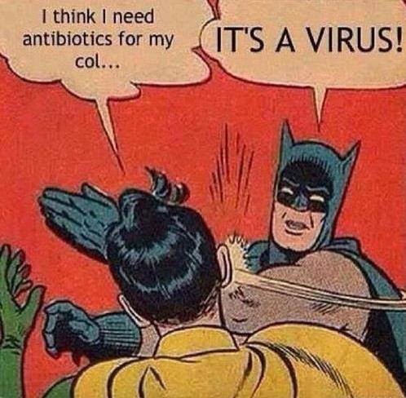
Severity-adjusted Admission Rates

Slide 17
Variation in Care
Dartmouth Atlas Project
http://www.dartmouthatlas.org/downloads/atlases/NNE_Pediatric_Atlas_121113.pdf
Inappropriate use of antibiotics for URI lowest in cities with a major pediatric hospital
Radiation exposure lowest in cities with a major pediatric hospital
Four-fold differences in tonsillectomy rates
Two-fold difference in emergency department use
Two-fold difference in hospitalization rate
The variation in use of antibiotics among cities is 1.8 fold

Slide 18
Changing Provider Practice with Audit and Feedback
Ivers N. Audit and feedback: effects on professional practice and healthcare outcomes. Cochrane Database Syst Rev. 2012
70 studies included audit and feedback
Median increase of 4.3% for proportion measures (IQR 0.5-16%)
Median increase of 1.3% for continuous measures (1.3-29%)
Effectiveness depended on
Low baseline performance
Feedback written and oral
Feedback more than once
Feedback from supervisor or colleague
Clear goal(s) articulated

Slide 19
Variation in Care

Slide 20
Variation in Care

Slide 21
Variation in Care

Slide 22
Variation in Care

Slide 23
Reducing CT Scans for Head Injury

Slide 24
Where Medicine is Headed
Report to the Virginia Legislature, 2014
http://web1.millercenter.org/commissions/healthcare/HealthcareCommission-Report.pdf
The traditional fee-for-service payment model promotes fragmentation and higher spending
Physician, facility, and drug costs are high
Americans use a higher proportion of expensive medicine
Care is fragmented and uncoordinated

Slide 25
Where Medicine is Headed
Recommendations:
Collect detailed data on health spending throughout the state
Define and collect data on the quality of health care delivery
Adopt annual spending benchmarks for the next 5 years
Adopt annual benchmark goals on quality for the next 5 years

Slide 26
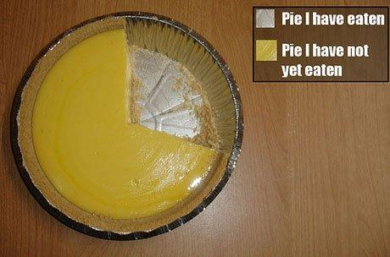
Data-driven Care

Slide 27
Genomics/Biomics
Goldin BR and GSL. Probiotics overview. Clin Inf Dis 2008.
Acute diarrhea
C. Difficile
Cow milk allergy
UTI
? Respiratory infections, dental caries, IBS, IBD
Colvin JM et al. Pediatrics 2012.
Viral passengers
35% of elective pediatric surgery patients carry viruses
But no inflammatory response
Scott J. A wash on the wild side. NY Times May 25, 2014.
Nitrosoma eutropha BID “misting”
Reduces Staph aureus
Reduces propioniacterium
Improves wound healing in diabetic mice

Slide 28
Summary
Autoinjector for SE (coming soon?)
Any of the 3 benzos is fine
Further reducing radiation exposure for children
Patient-centered care is not the same as patient satisfaction
We will be accountable for our quality and reducing unexplained variation
Make friends with your biome

